Slide 1
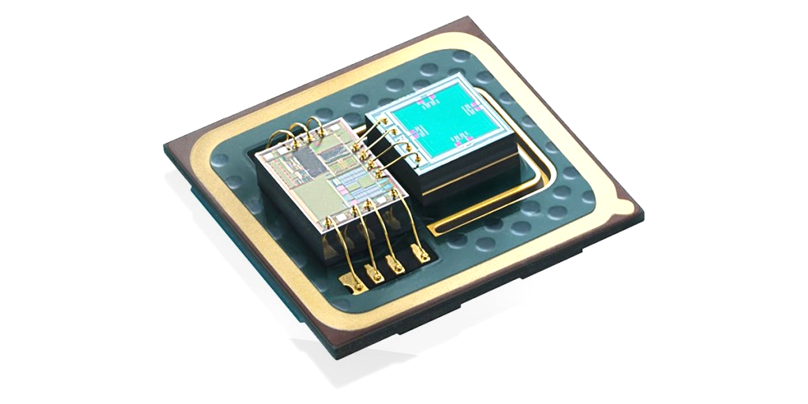

SCHOOL OF ELECTRICAL AND ELECTRONICS ENGINEERING (SEEE)
CAPSTONE PROJECT
2020-2024 BATCH
Design and Optimization of Piezoresistive Pressure Sensor
GROUP MEMBERS :
Anirudh Santhosh (20BAC10003)
Nibedita Rakshit (20BAC10024)
Varun Ram S (20BAC10038)
Rishita Singh (20BEC10024)
SUPERVISOR NAME:
Dr. M. Suresh
Date : 24 November 2023

Slide 2
REVIEW 0
A Short Recap

Slide 3

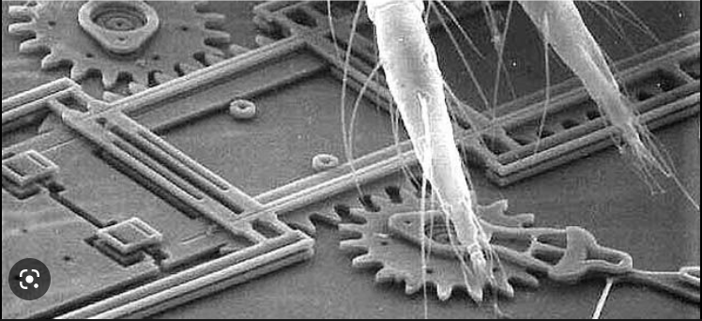
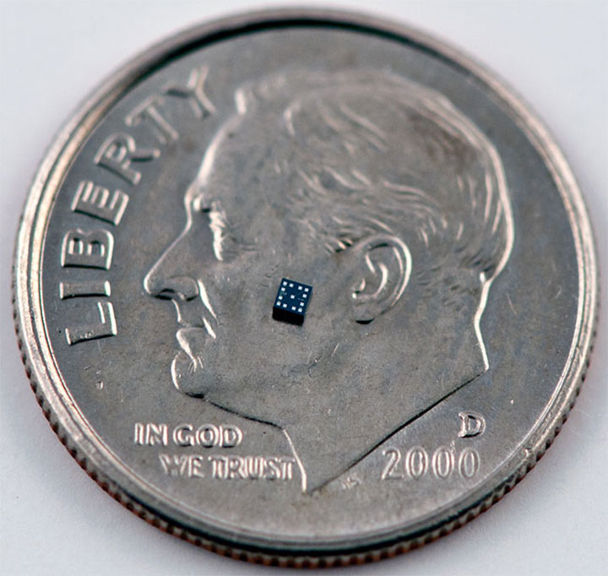

Micro-Electromechanical Systems (MEMS)
Small integrated devices or systems which combine electrical and mechanical components like microsensors , microactuators , signal transduction elements.
The size varies from micrometers to millimeter level.
A mechanical platform (movable)
+
Electronics (Interfacing circuit)
Physical input
Pressure , Force
Microsensor,Microsensing
Transduction stage
Microactuator , Micro Actuating element
Output
fig 1 20um view
fig 2 Size comparison

Slide 4
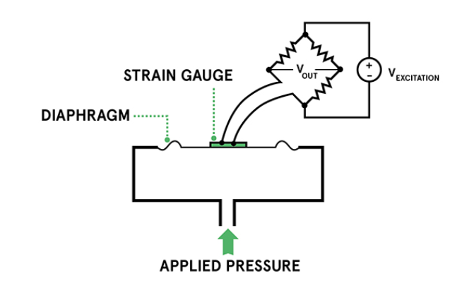
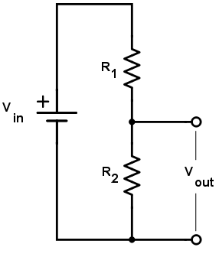

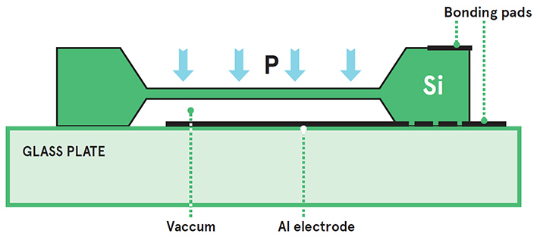
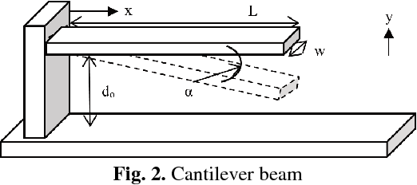
MEMS PIEZORESISTIVE SENSOR:
Interfacing circuits
Electronics
Structure (movable)

Slide 5
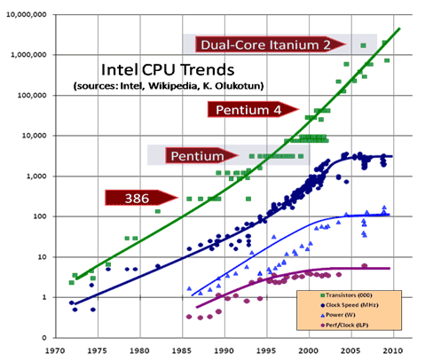
Objective:
To develop a miniaturized piezoresistive pressure sensor with high sensitivity.
Why Piezoresistive ?
Stability despite of Lightweight, high gauge factors
Simplest to fabricate
Provides electrical output directly
fig 1 Miniaturization leading to more no. Transistors per chip

Slide 6
Problem Statement:
Pressure sensors have found a wide range of applications, especially in biomedical and clinical applications. However, there is a requirement for high sensitivity, and miniaturized sensors.
The sensor design is a tradeoff between performance metrics sensitivity, stability, bio-compatibility and cost effectiveness.
Our motive: To simulate/model high-sensitivity and miniaturized sensors for biosensing applications.

Slide 7
REVIEW 1

Slide 8

Work Plan:
Literature Review
Diving into the Software
Simulation
Geometry Selection
Material Selection
Optimization
Research Paper
Writing
Compilation of the Project

Slide 9
Literature Review

Slide 10
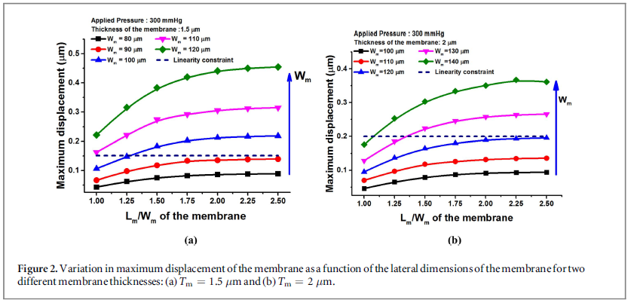
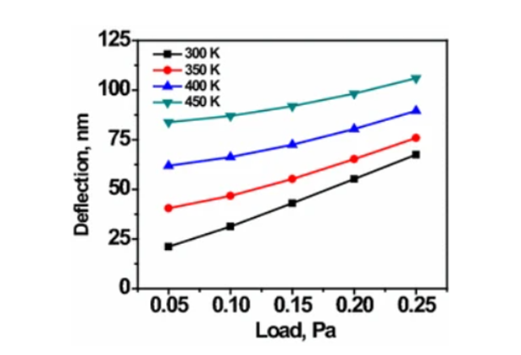
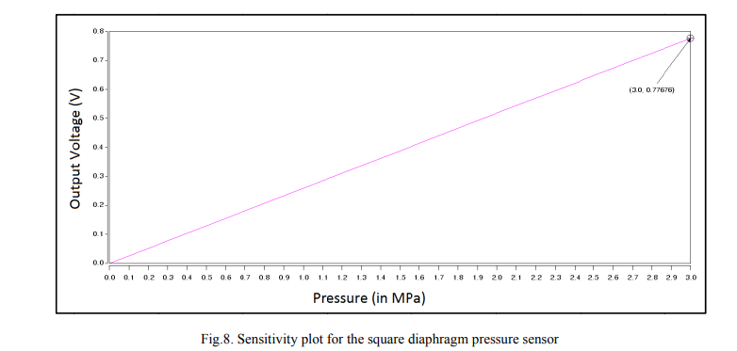
A Few analyses from Research paper
Paper 7: Three- Terminal Piezoresistor
Paper 4: Pressure vs deflection (Thermomechanical analysis)
Paper 1 : Sensitivity plot

Slide 11
Available Geometries and Designs of Devices
Sr No | Materials Used | Geometries
1
2
3
4
5
6
7
8
9
10
Diaphragm | Piezoresistor
n-Silicon [7],[1] | p- Silicon [7],[1]
Silicon [9] | Graphene [9]
SiN [4] | Polysiloxane
PolySilicon [4] | Aluminium [4]
Cr Film [4] | Germanium
Platinum Film [4] | Gallium Arsenide
SiC [5] | Platinum [5] Circular[1] Meander[1]
SiO2 [2] | Silicon [2]
SNW (Silicon Nanowire)[3] | Nichrome
CNT (Carbon Nanotube)[3]
Diaphragm | Piezoresistor
Rectangular [7] | T-Shape [7]
Square [9] | Serpentine [9]
Rectangular[4] | U-Shape [6]
E-shape [6] | W-Shape [6]
U-Shape | Line- Shape [6]
Square [8] | Helical Shape

Slide 12
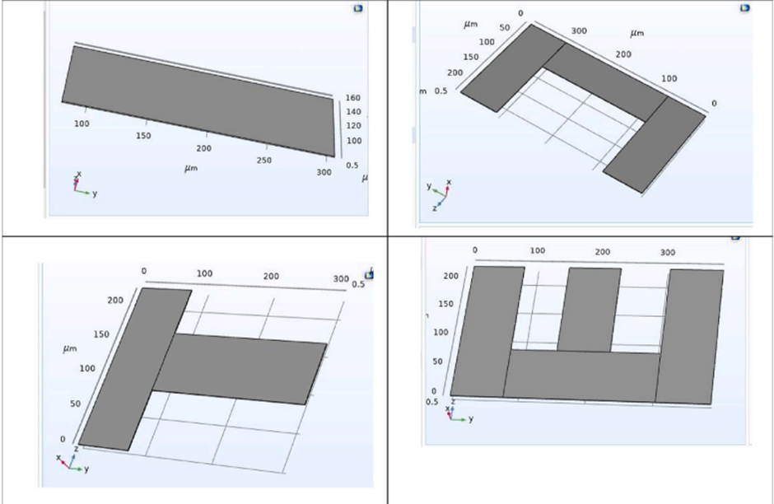
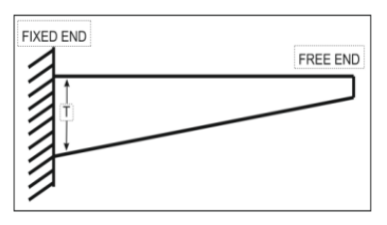
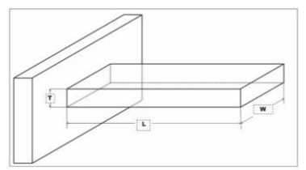
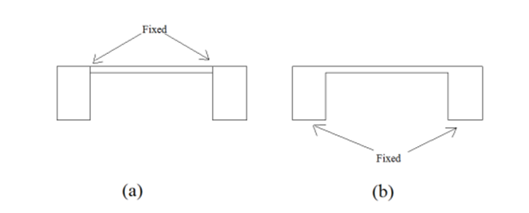
Device Designs
2) Cantilever [5]
Line shape , U shaped , T shaped , E shaped [2]
3) Regular Rectangular Diaphragm [1]

Slide 13
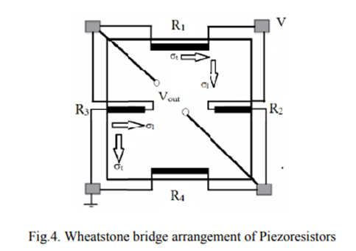
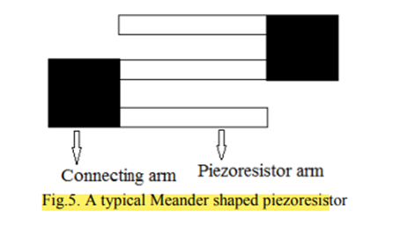
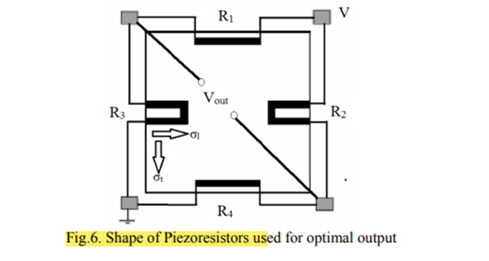
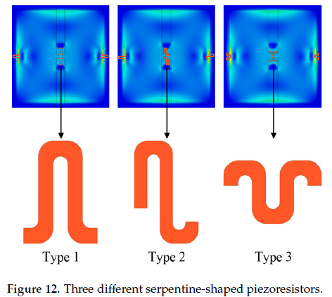
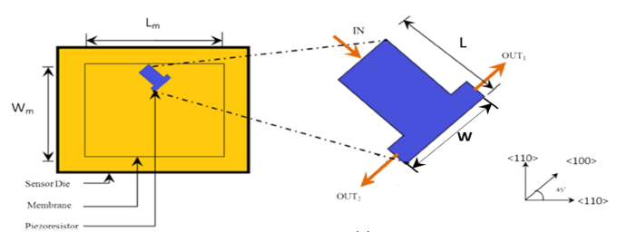
Piezoresistor designs
Wheatstone Bridge arrangement for Piezoresistors [1]
Meander shaped Piezoresistor [1]
Shape of Piezoresistor used for Optimal Output [1]
Diagram of a Three- Terminal Piezoresistor [7]

Slide 14



Software used

Slide 15
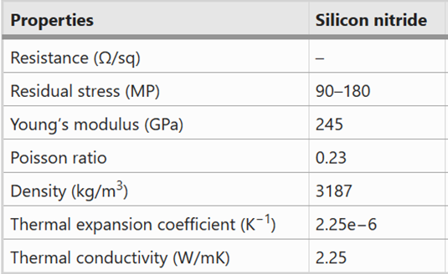
Specifications of Benchmark design
Material used
SiN
300 um
150 um
350 um
87.5 um

Slide 16
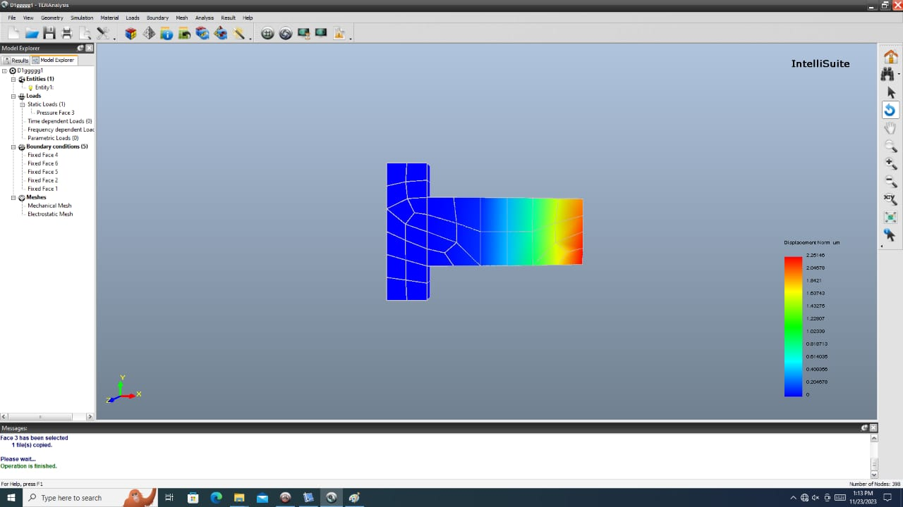
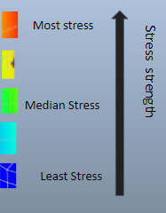
Cantilever benchmark design using Intellisuite ( Replication )
0.1 Pa across the surface

Slide 17
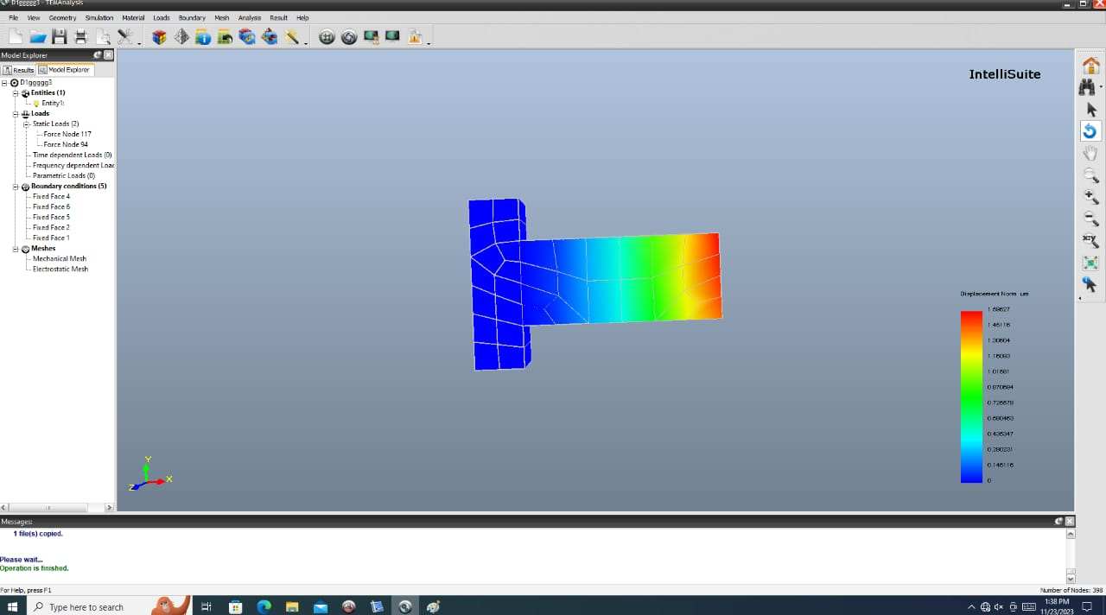
Nodal Force input
Most stress
Estimated force at node
Stress strength
Median Stress
Least Stress

Slide 18
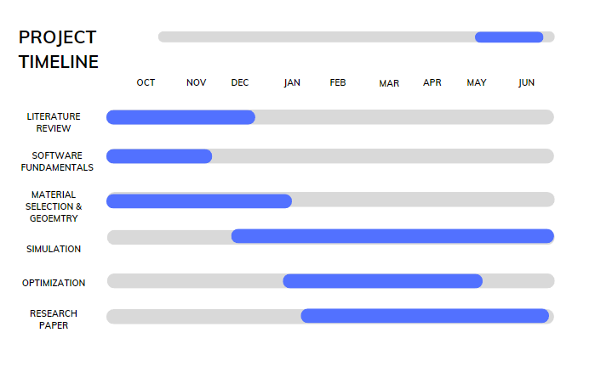

TIMELINE
.

Slide 19
Reference(s)
[1] Kumar, S. and Pant, B.D., 2012, October. Design of piezoresistive MEMS absolute pressure sensor. In 16th International Workshop on Physics of Semiconductor Devices (Vol. 8549, pp. 308-317). SPIE.
[2] Suresh, V. and Kumar, B.R., 2023. Design of piezoresistive pressure sensor for enhancing stress of MEMS cantilever. Measurement: Sensors, 25, p.100637.
[3] Meena, K. V., and A. Ravi Sankar. "Biomedical catheters with integrated miniature piezoresistive pressure sensors: A review." IEEE Sensors Journal 21.9 (2021): 10241-10290.
[4] Girija, K.G., Tushir, I., Vatsa, R.K. and Topkar, A., 2017. Design, simulation and fabrication of piezoresistive microcantilevers using standard multi user MEMS process. ISSS Journal of Micro and Smart Systems, 6, pp.83-89.
[5] Devkare, S.S. and Bhole, K.S., 2020, March. Review of Micro cantilever sensors for detecting diseases: Fabrication Methodologies and sensing techniques. In IOP Conference Series: Materials Science and Engineering (Vol. 810, No. 1, p. 012069). IOP Publishing.
[6] Tian, B., Shang, H., Zhao, L. and Wang, W., 2021. Performance optimization of SiC piezoresistive pressure sensor through suitable piezoresistor design. Microsystem Technologies, 27, pp.3083-3093.
[7] Meena, K.V., Mathew, R. and Sankar, A.R., 2017. Design and optimization of a three-terminal piezoresistive pressure sensor for catheter based in vivo biomedical applications. Biomedical Physics & Engineering Express, 3(4), p.045003.
[8] Chen, S., Zhu, M.Q., Ma, B.H. and Yuan, W.Z., 2008, January. Design and optimization of a micro piezoresistive pressure sensor. In 2008 3rd IEEE International Conference on Nano/Micro Engineered and Molecular Systems (pp. 351-356). IEEE.
[9] Ren, X., Liu, X., Su, X. and Jiang, X., 2022. Design and optimization of a pressure sensor based on serpentine-shaped graphene piezoresistors for measuring low pressure. Sensors, 22(13), p.4937.

Slide 20

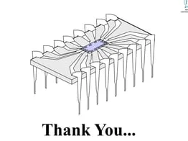

Slide 21
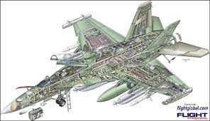
Literature Review
Paper Title: Harsh Environment Silicon Carbide Sensors for Health and Performance Monitoring of Aerospace Systems: A Review
Advancement in SiC process technology and demonstration of SiC based sensors and electronic circuits in hostile environment.
Leads to the use of SiC technology for health and performance monitoring in Aerospace systems.

Slide 22
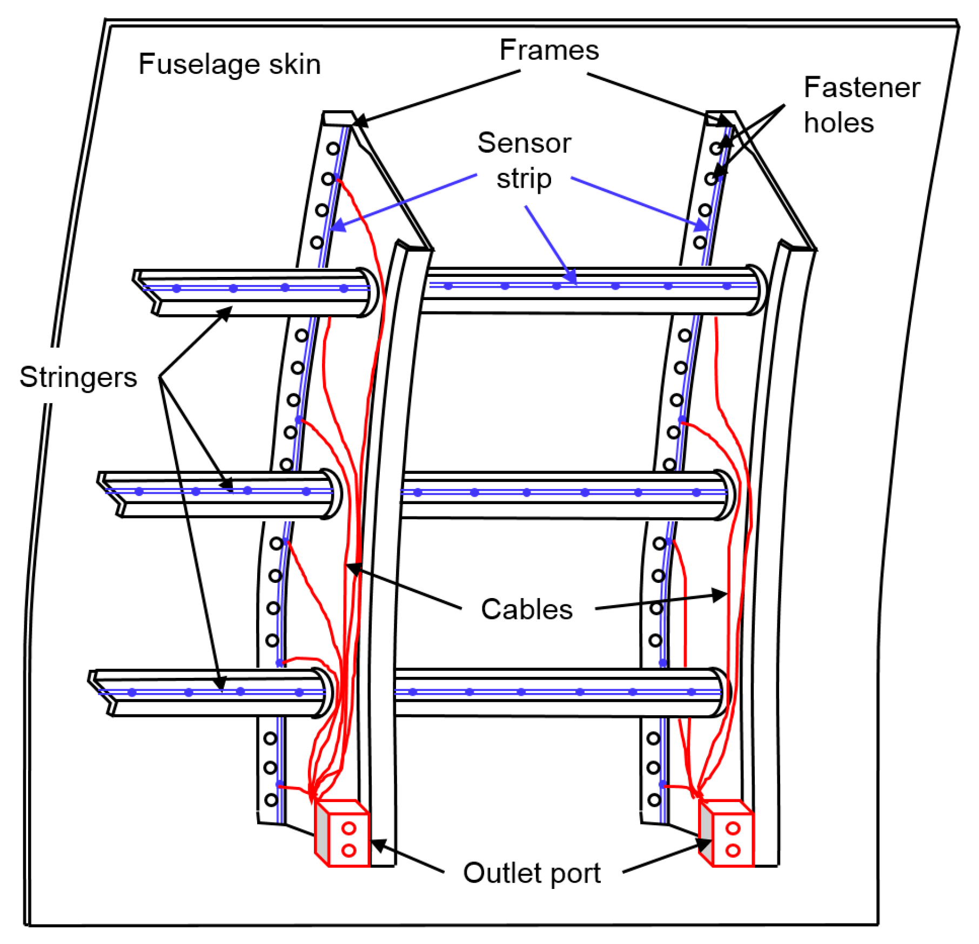
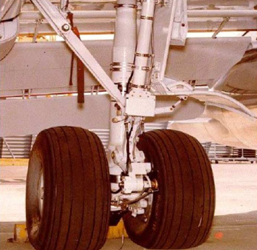
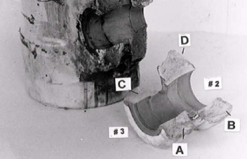
Possible location of sensors and their types used for real-time health and performance monitoring of aerospace systems.
1). Fuselage(Body): Strain and vibration sensors
2). Jet Engine: Pressure, temperature and strain sensors
3). Wing: Strain and vibration sensors
4). Landing Gear: Strain and vibration sensors

Slide 23
Literature Review
Paper Title: Silicon Carbide Converters and MEMS Devices for High-temperature Power Electronics: A Critical Review
The paper begins with an introduction to the concept of high-temperature power electronics and the need for new materials that can withstand extreme temperatures and provide better performance than traditional materials.
The authors then discuss the properties of SiC that make it an attractive material for high-temperature power electronics, such as its high thermal conductivity, wide bandgap, and high breakdown voltage
The authors also discuss the current state of research in this field, including recent advancements in SiC-based power devices and MEMS devices.

Slide 24
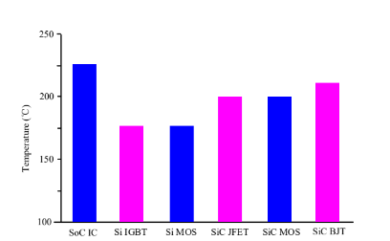
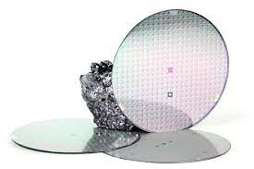
The paper identifies several key challenges that need to be addressed to fully realize the potential of SiC in high-temperature power electronics, such as improving device reliability and reducing manufacturing costs.
Finally, the paper concludes with a discussion of future directions for research in this field and the potential impact of SiC-based power electronics and MEMS devices on various industries, including automotive, aerospace, and energy.
Fig. The maximum operating temperature of SiC power electronic devices.
Fig. Silicon Carbide material for chips

Slide 25
References
C. Hautamaki, S. Zurn, S. C. Mantell, and D. L. Polla, “Experimental evaluation of MEMS strain sensors embedded incomposites,” J. Microelectromech. Syst., vol. 8, no. 3, pp. 272–279, 1999
R. G. Azevedo, D. G. Jones, A. V. Jog, B. Jamshidi, D. R. Myers, L. Chen, X. Fu, M. Mehregany, M. B. J. Wijesundara, and A. P. Pisano, “A SiC MEMS resonant strain sensor for harsh environment application,”IEEE Sensors J., vol. 7, no. 4, pp. 568–576, Apr. 2007.
D. Gao, M. B. J. Wijesundara, C. Carraro, R. T. Howe, and R.Maboudian, “Recent progress toward a manufacturable polycrystalline SiC surface micromachining technology,” IEEE Sensors J., vol.4, pp. 441–448, 2004.
B. Jamshidi, “Poly-crystalline silicon carbide passivated capacitive MEMS strain gauge for harsh environment,” Ph.D. dissertation, Dept. Mech. Eng., Univ. California,, Berkeley, 2008.

